Slide 1
ERGONOMICS while working from home
EM561 – Facilities Systems Design
Presented by Geethikaa Desam, Ruchika Soni, Rohan Agarwal, Uthman Ndayako

Slide 2
PROBLEM STATEMENT
The problem with working from home is the difficulty of incorporating appropriate ergonomics in the home-work-place, which could result in muscular injuries in the long run if ignored, unlike an office settings where the workstations are designed in adherence to ergonomic guidelines.

Slide 3

What is Ergonomics?
It is the “scientific discipline concerned with understanding of interactions among humans and other elements of a system, and the profession that applies theory, principles, methods and data to design in order to optimize human well-being and overall system performance”.

Slide 4
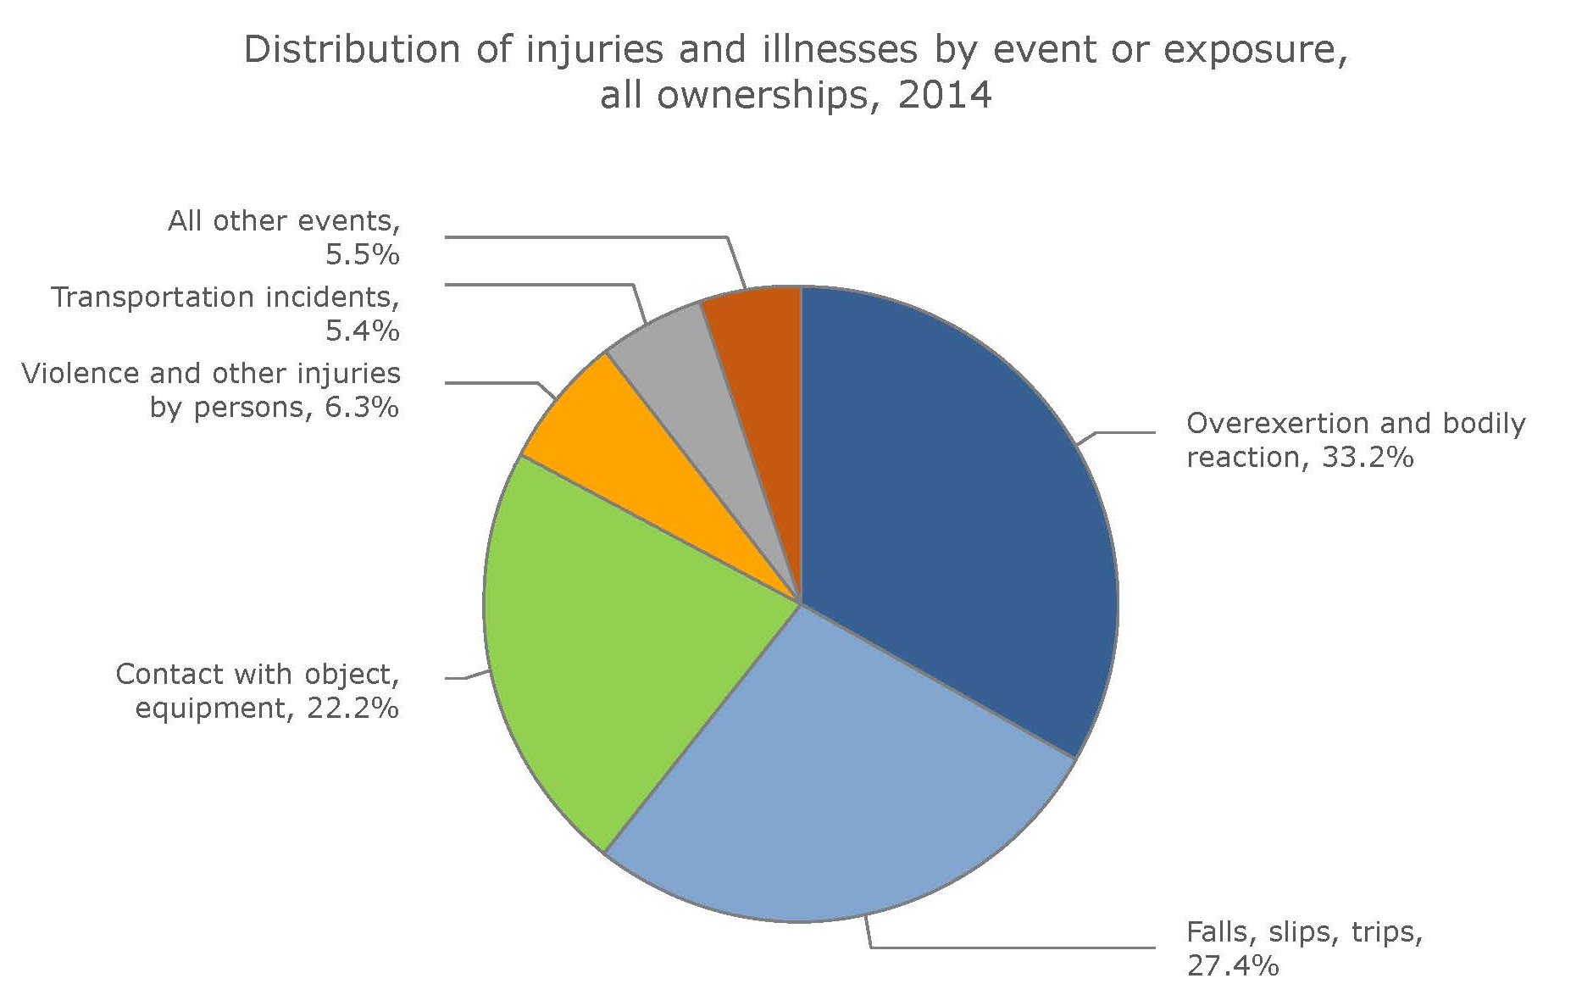
INJURIES EXPLAINED
This chart shows how Musculoskeletal Disorders (MSDs) compare to other hazards based on percentage of injuries and illnesses using statistics from the Bureau of Labor Statistics, FY2014.

Slide 5
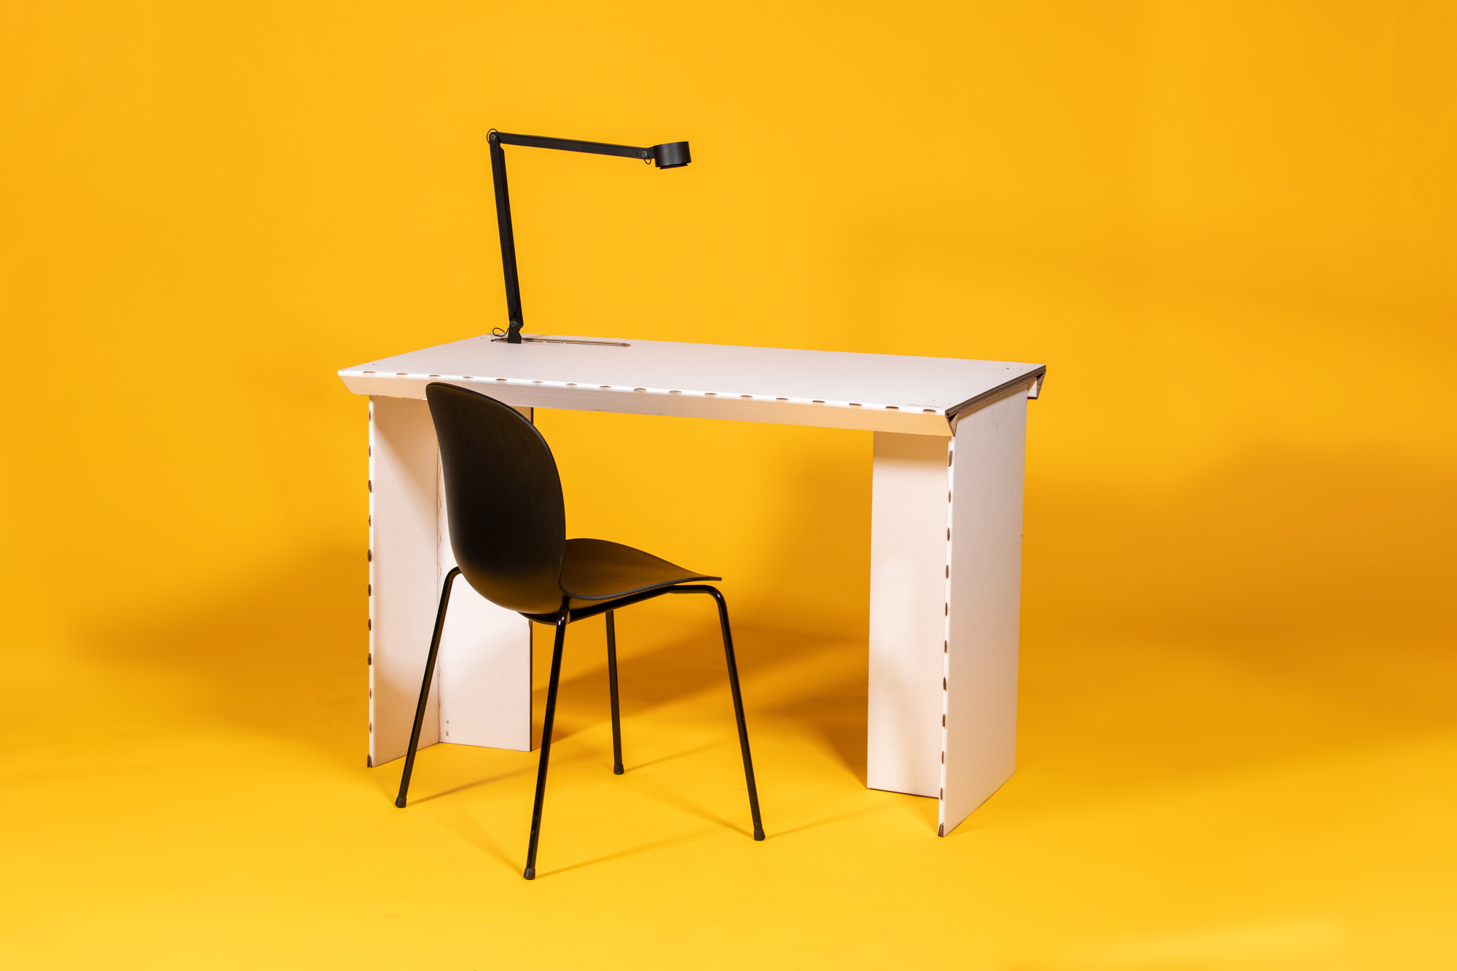
IMPORTANCE OF ERGONOMICS
01
02
03
Ergomation
Flexibility
Modularity

Slide 6
PRINCIPLES OF ERGONOMICS
1
2
3
Hand Motions
Motion Types – Ballistic motion; Restricted motions; Continuous motion
Location of parts and tools
4
5
6
Freeing the hands as much as possible
Gravity
Operator Safety and Health Considerations

Slide 7

ANALYSIS OF VARIOUS SETUPS
(REAL LIFE EXAMPLES)

Slide 8
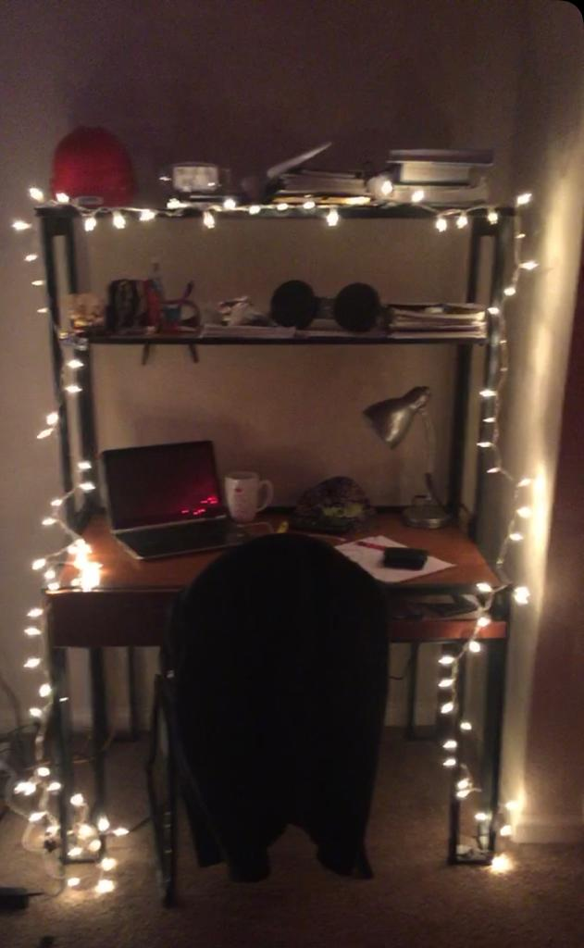
STUDENT WORKSTATION
Brand – N/A
Cost - N/A
Ergonomic Rating – 41
Area – 10sqft
(Provided by University Dorm)
MARS
Workstation - 1

Slide 9
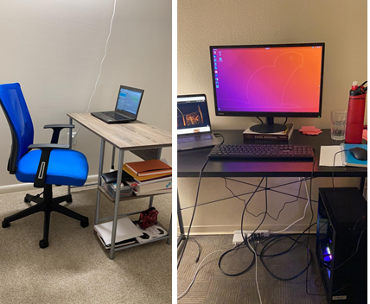
STUDENT WORKSTATION
Table – Walmart , IKEA - $60 each
Chair – Office Depot - $70
Ergonomic Rating – 38
Area - 20 sqft.
Workstation - 2

Slide 10
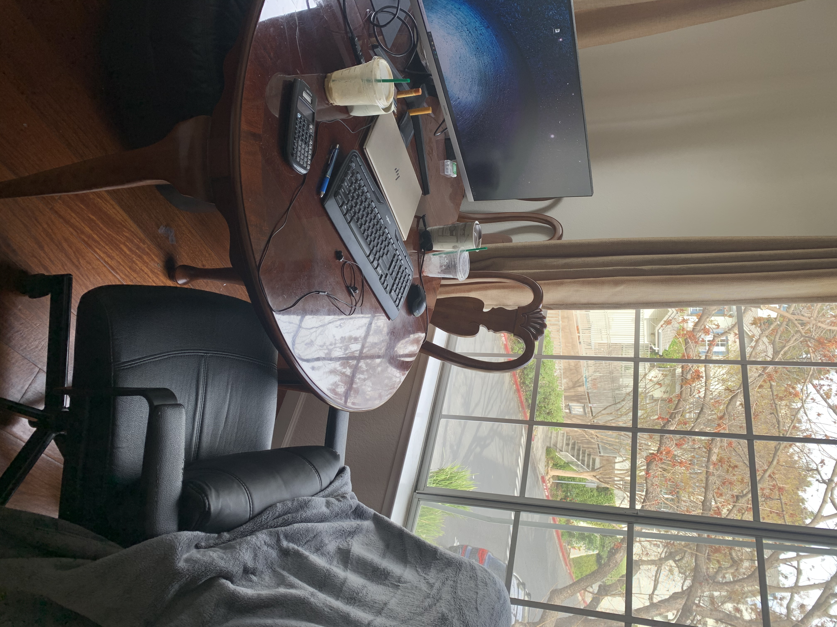
STUDENT WORKSTATION
Table - Courtesy of landlord
Chair – Office depot - $130
Back support pillow- $30
Ergonomic Rating – 43
Area – 22sqft
MARS
Workstation - 3

Slide 11
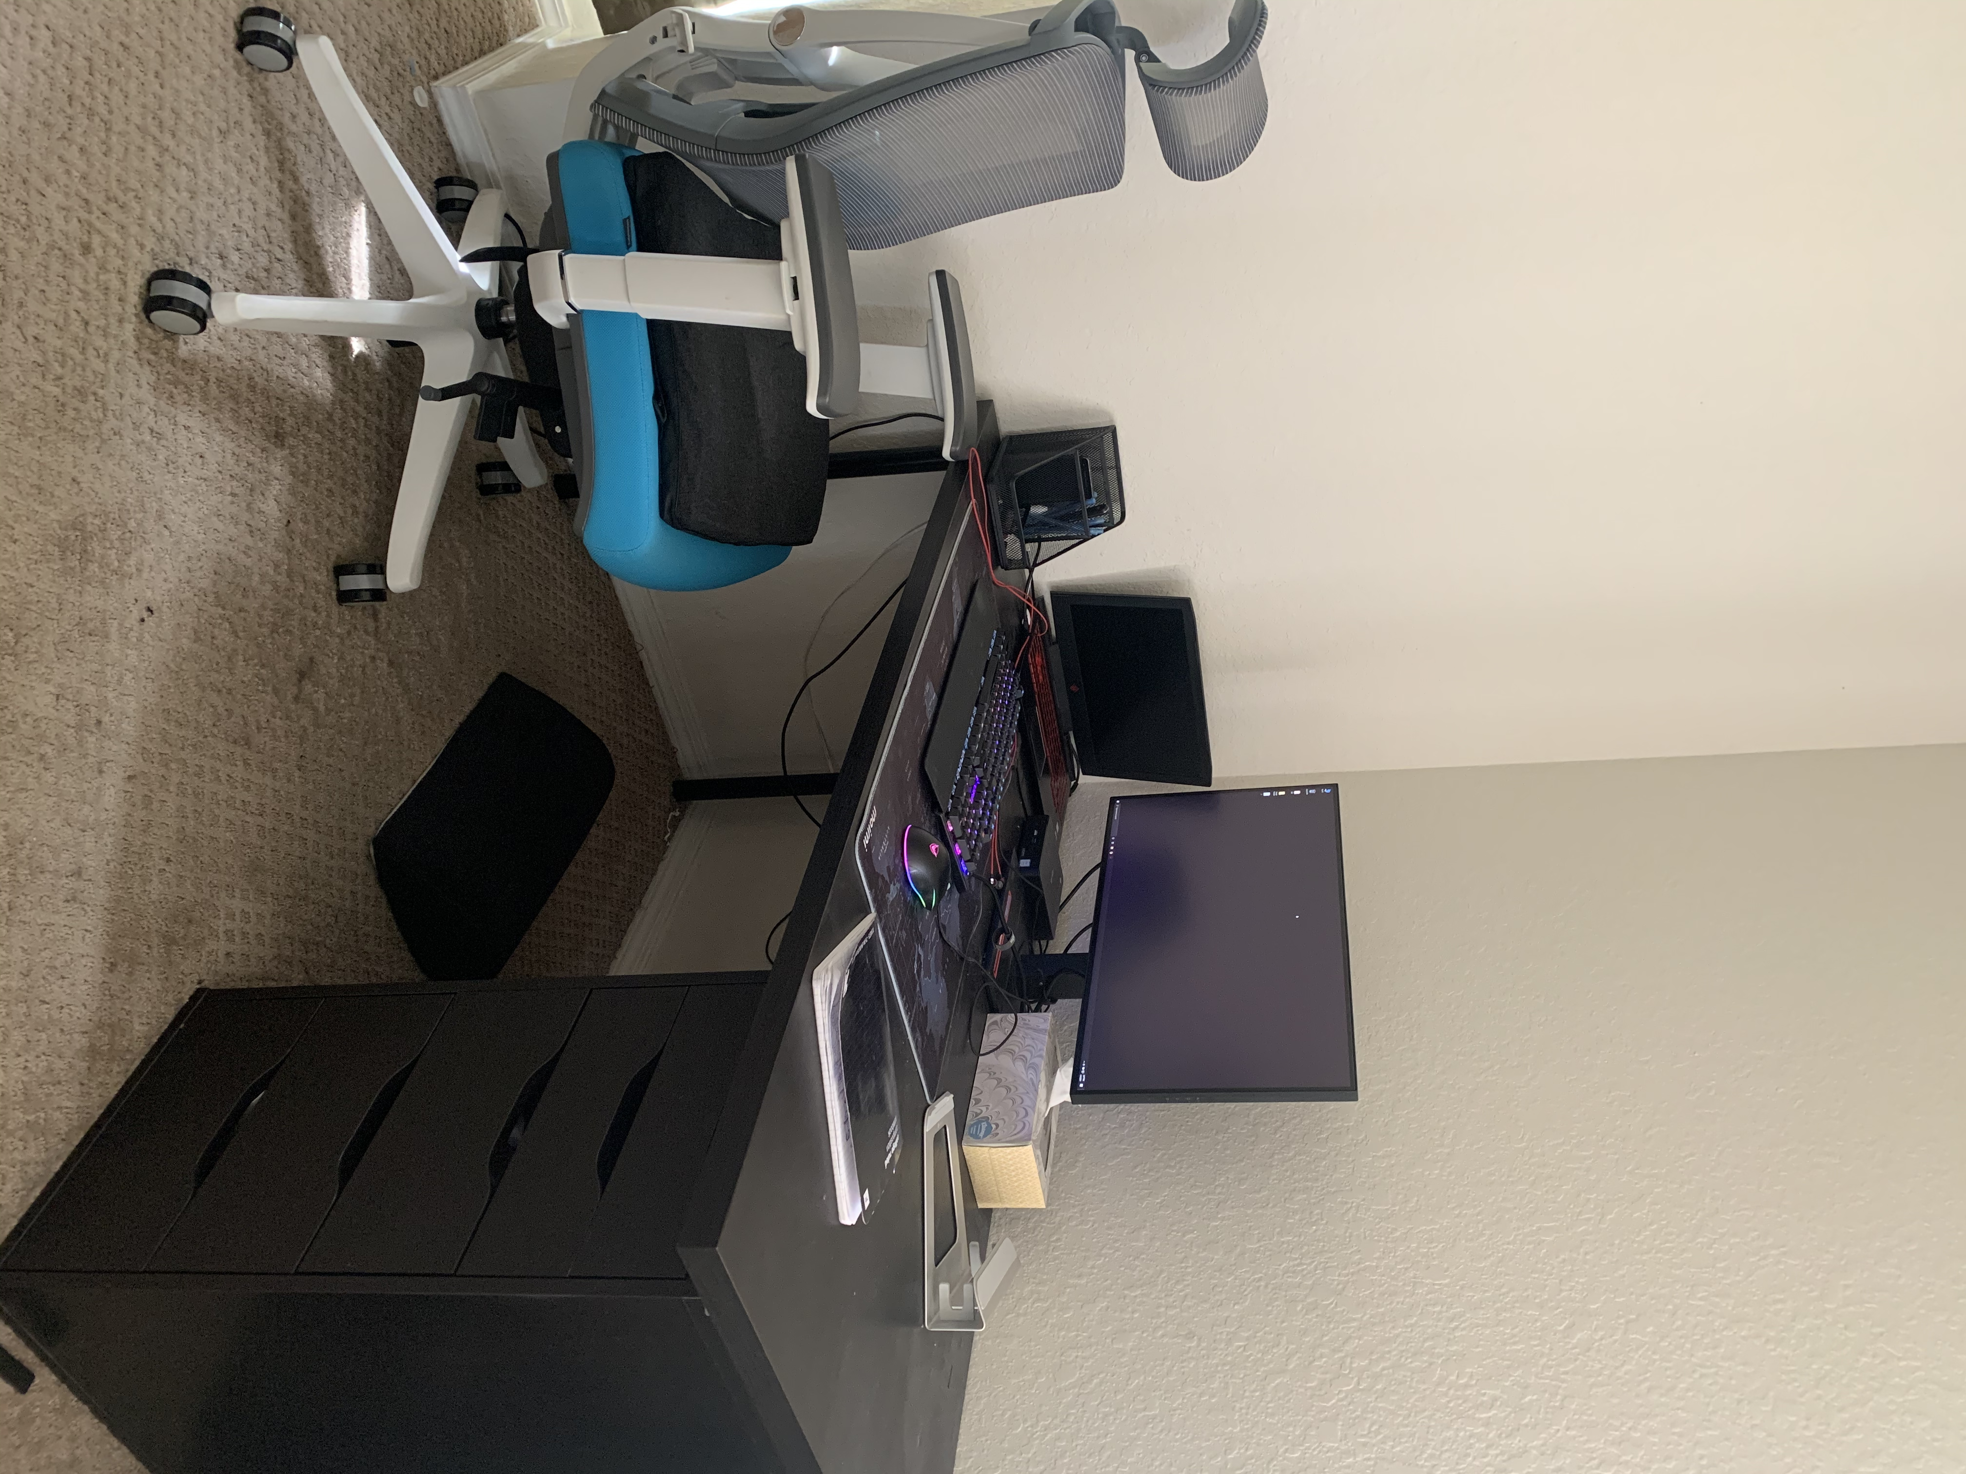
PROFESSIONAL WORKSTATION
Table:
Horizontal station – IKEA - $60
Drawers – IKEA - $40
Stands – IKEA - $40
Chair:
Autonomous AI - $228
Support Cushion – Purple Mattress - $80
Foot Support – Amazon - $40
Ergonomic Rating – 30
Area – 21sqft
Workstation – 4

Slide 12
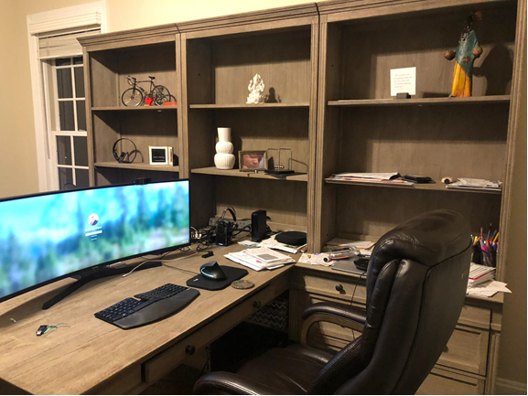
PROFESSIONAL WORKSTATION
Table:
Wayfair- $600
Chair:
La-z-boy - $400
Ergonomic Rating – 27
Area – 60sqft
Workstation – 5

Slide 13
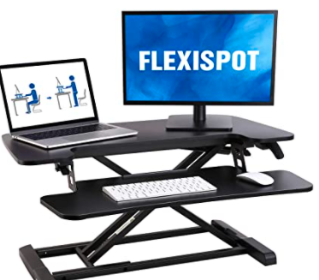
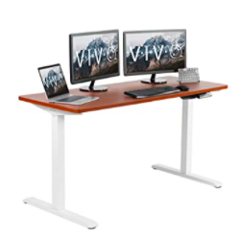
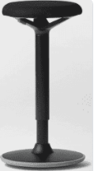
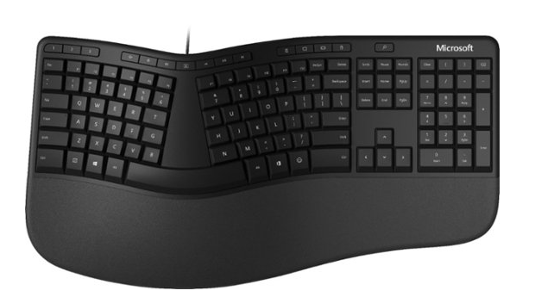
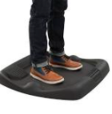

NEW TRENDS
Workstation – 6

Slide 14
AVOIDING INJURY AT HOME
Analyze stress nodes and adjust your workstation
Invest in little ergonomic helpers like a stress ball to exercise the palm, a standing mat to relieve pressure on the feet while working on a standing desk.
Stretch your muscles
Avoid slouching and working from the couch for extended periods of time.
Practice proper posture.
Ensure proper lumbar support while sitting

Slide 15
CONCLUSION
Average student workstation currently carries an orange rating.
Current Professional workstation carries a white band rating
$150-$500 is the average price of a good workstation
Average space required is 30 sq.ft.

Slide 16
RESOURCES
Stephens, M. P. (2019). Manufacturing facilities design & material handling. Purdue University Press.
Chairs. La. (n.d.). https://www.la-z-boy.com/b/chairs/_/N-otsk94.
Verify your identity. (n.d.). https://www.walmart.com/browse/home/executive-office-chairs/4044_103150_97116_3896177.
Verify your identity. (n.d.). https://www.walmart.com/browse/home/desks/4044_103150_97116_91851?povid=4044%2B%7C%2B2018-04-30%2B%7C%2BDesksNavbar.
Ergonomic Office Chairs: Office Depot & OfficeMax. officedepot.com. (n.d.). https://www.officedepot.com/a/browse/ergonomic-office-chairs/N=5+593065/.
Office Furniture Sets. Wayfair. (n.d.). https://www.wayfair.com/furniture/sb0/office-furniture-sets-c251662.html.
Autonomous. (2018, November 2). ErgoChair 2 - The Ergonomic Chair Every Office Needs. autonomous. https://www.autonomous.ai/office-chairs/ergonomic-chair.

Slide 17
THANK YOU

